Slide 1
Week Fifteen– Class One

Slide 2
Errors!
In software industrial programming most of the programs contain bugs. Errors can be broadly categorized into two types. We will discuss them one by one.
Compile Time Errors
Run Time Errors
Compile Time Errors – Errors caught during compiled time is called Compile time errors. Compile time errors include library reference, syntax error or incorrect class import. Syntax errors Semantic errors
Run Time Errors - They are also known as exceptions. An exception caught during run time creates serious issues.

Slide 3
Exception!
An exception is a situation, which occurred by the runtime error. In other words, an exception is a runtime error. An exception may result in loss of data or an abnormal execution of program.
Errors hinder normal execution of program
Exception handling is the process of handling errors and exceptions in such a way that they do not hinder normal execution of the system
It is a new feature that ANSI C++ included in it. Now almost all C++ compilers support this feature.

Slide 4
Exceptions!
Exceptions are different, however. You can't eliminate exceptional circumstances; you can only prepare for them. Your users will run out of memory from time to time, and the only question is what you will do. Your choices are limited to these:
Crash the program.
Inform the user and exit gracefully.
Inform the user and allow the user to try to recover and continue.
Take corrective action and continue without disturbing the user.

Slide 5
Exception
For example,
User divides a number by zero, this will compile successfully but an exception or run time error will occur due to which our applications will be crashed. In order to avoid this we'll introduce exception handling technics in our code.

Slide 6
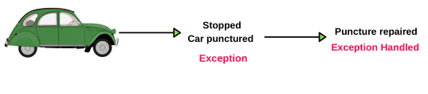
Exception
For example,
Suppose a person is traveling by car from Mumbai to Pune. After traveling mid-distance, the tire of his car is punctured. This unexpected or unwanted event is nothing but an exception.
The car owner always keeps an extra tire as an alternative on a long-distance journey. He changes the punctured tire by a new tire. After changing the tire, he continues the rest of the journey. This alternative way is called exception handling.

Slide 7
Exceptions!
Exceptions provide a way to transfer control from one part of a program to another. C++ exception handling is built upon three keywords: try, catch, and throw.
throw − A program throws an exception when a problem shows up. This is done using a throw keyword.
catch − A program catches an exception with an exception handler at the place in a program where you want to handle the problem. The catch keyword indicates the catching of an exception.
try − A try block identifies a block of code for which particular exceptions will be activated. It's followed by one or more catch blocks.

Slide 8
Exceptions
try {
// protected code
} catch( ExceptionName e1 ) {
// catch block
} catch( ExceptionName e2 ) {
// catch block
} catch( ExceptionName eN ) {
// catch block
}
You can list down multiple catch statements to catch different type of exceptions in case your try block raises more than one exception in different situations.

Slide 9
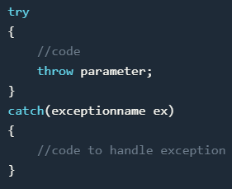
try {} block
The code which can throw any exception is kept inside(or enclosed in) a try block. Then, when the code will lead to any error, that error/exception will get caught inside the catch block.

Slide 10


catch {} block
This block catches the error thrown by try block. This block contains method to customize error.
Syntax:
catch
{
//defines method to control error;
}

Slide 11
throw function
This function is used to transfer the error from try block to catch block. This function plays major role to save program from crashing.
Syntax:
throw(variable);

Slide 12
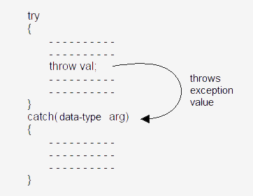
Exception Flow!

Slide 13
try-blocks and if-else
try-blocks are very similar to if-else statements
If everything is normal, the entire try-block is executed
else, if an exception is thrown, the catch-block is executed
A big difference between try-blocks and if-else statements is the try-block's ability to send a message to one of its branches

Slide 14

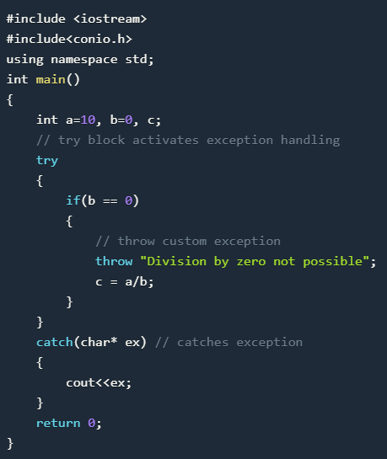
EXAMPLE

Slide 15
Using Multiple catch blocks
int main()
{
int x[3] = {-1,2};
for(int i=0; i<2; i++)
{
int ex = x[i];
try
{
if (ex > 0)
// throwing numeric value as exception
throw ex;
else
// throwing a character as exception
throw 'ex';
}
catch (int ex) // to catch numeric exceptions
{
cout << "Integer exception\n";
}
catch (char ex) // to catch character/string exceptions
{
cout << "Character exception\n";
}
}
}

Slide 16
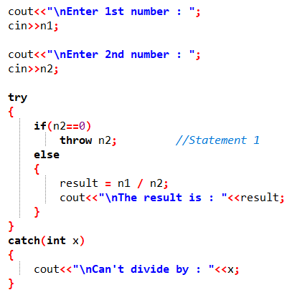
Example of simple try-throw-catch

Slide 17
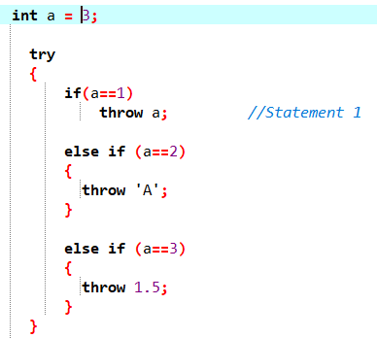
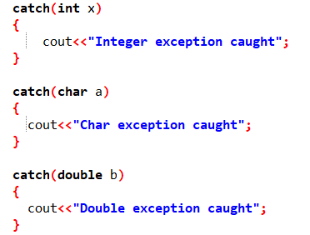
Multiple Catches

Slide 18
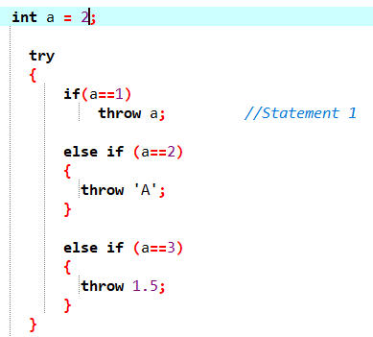
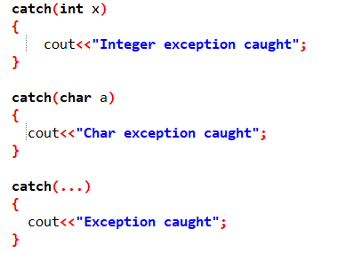
Catch all exceptions / Default Catch

Slide 19
Without catch
#include <iostream>
#include <exception>
using namespace std;
double zeroDivision(int x, int y) {
if (y == 0) {
throw y;}
return (x / y);}
int main() {
int numerator;
int denominator;
double result;
cout << "enter numerator and denominator: " << endl;
cin>>numerator>>denominator;
try {
result = zeroDivision(numerator, denominator);
cout << "result is " << result << endl; }
return 0;}

Slide 20

Without catch

Slide 21
If an exception is thrown and not caught anywhere, the program terminates abnormally.
#include <iostream>
using namespace std;
int main(){
try {
throw 'a'; }
catch (int x) {
cout << "Caught "; }
return 0;}

Slide 22
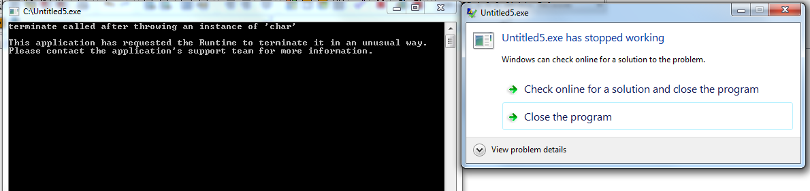
Implicit type conversion doesn’t happen for primitive types. For example, in the following program ‘a’ is not implicitly converted to int

Slide 23
Correct version
#include <iostream>
using namespace std;
int main()
{
try {
throw 'a';
}
catch (int x) {
cout << "Caught " << x;
}
catch (...) {
cout << "Default Exception\n";
}
return 0;
}

Slide 24
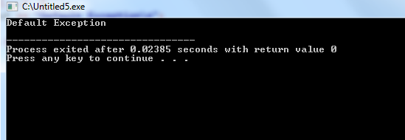
output

Slide 25
Exception Handling Checklist
Try block has the main code, which code may throw an exception.
Multiple throws are possible to declare in try block based different situations.
The catch block contains exception handling code that is executed when thrown by the Try Block.
Possible to declare one or more catch block for different type of exception
No code can be between try block and the first catch block.
Catch blocks declare directly after the try block.

Slide 26
Exception Instead of if-else
The problem with relying only on if/else without using try/catch is that it creates a lot of unnecessary code when you are trying to handle errors. With try/catch you can have multiple functions inside of a try and gracefully handle any errors in the catch.
In general, try-catch blocks are great because they will break (move to the catch statement) whenever the exception occurs. If-else blocks rely on you predicting when the error will happen

Slide 27

Example
#include<iostream>
#include<vector>
using namespace std;
int main() {
vector<int> vec;
vec.push_back(0);
vec.push_back(1);
// access the third element, which doesn't exist
try
{
vec.at(2);
throw 'a';
}
catch (exception& ex)
{
cout << ex.what() <<endl;
}
return 0;
}

Slide 28
Generalized catch block in C++
int main()
{
int x[3] = {-1,2};
for(int i=0; i<2; i++)
{
int ex=x[i];
try
{
if (ex > 0)
throw ex;
else
throw 'ex';
}
// generalised catch block
catch (...)
{
cout << "Special exception\n";
}
}
return 0;
}

Slide 29
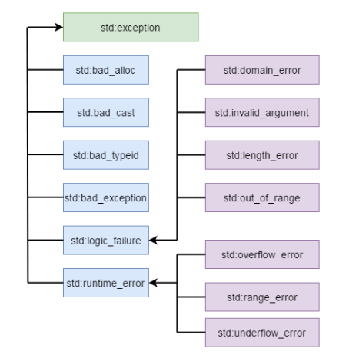
C++ Standard Exceptions

Slide 30
C++ Standard Exceptions
std::exception | This is an exception and the parent class of all standard C++ exceptions.
std::bad_alloc | This exception is thrown by a new keyword.
std::bad_cast | This is an exception thrown by dynamic_cast.
std::bad_exception | A useful device for handling unexpected exceptions in C++ programs.
std::bad_typeid | An exception thrown by typeid.
std::logic_error | This exception is theoretically detectable by reading code.
std::domain_error | This is an exception thrown after using a mathematically invalid domain.
std::invalid_argument | An exception thrown for using invalid arguments.
std::length_error | An exception thrown after creating a big std::string.
std::out_of_range | Thrown by at method.
std::runtime_error | This is an exception that cannot be detected via reading the code.
std::overflow_error | This exception is thrown after the occurrence of a mathematical overflow.
std::range_error | This exception is thrown when you attempt to store an out-of-range value.
std::underflow_error | An exception thrown after the occurrence of mathematical underflow.

Slide 31
Example 1
#include <iostream>
using namespace std;
int main(){
string word="four";
try{
cout<< word.at(4);
}
catch(int e){
cout<<endl;
cout<<"Exception thrown" ;
}
cout<<endl;
cout<<"Programs End";
}

Slide 32
Example 2
#include <iostream>
#include <stdexcept>
using namespace std;
int main(){
string word="four";
try{
cout<< word.at(4);
}
catch(out_of_range& ex){
cout<<endl;
cout<<"Exception thrown"<<ex.what() ;
}

Slide 33
Cont..
catch(exception& ex){
cout<<endl;
cout<<"Second Exception";
cout<<"Exception thrown"<<ex.what() ;
}
cout<<endl;
cout<<"Programs End";
}

Slide 34
what()
Here, what() is a public method provided by exception class and it has been overridden by all the child exception classes. This returns the cause of an exception.
catch (exception& ex)
{
cout << ex.what() <<endl;
}

Slide 35
Example 2
#include <iostream>
#include <stdexcept>
using namespace std;
int main(){
string word="four";
try{
int *arr=new int[99999999999999999999999999];
}
catch(bad_alloc& ex){
cout<<endl;
cout<<"Exception thrown"<<ex.what();
}
cout<<endl;
cout<<"Programs End";
}

Slide 36
#include <iostream>
#include <stdexcept>
using namespace std;
int main(){
string word="four";
try{
throw exception();
}
catch(out_of_range& ex){
cout<<endl;
cout<<"Exception thrown"<<ex.what() ;
}
catch(exception& ex){
cout<<endl;
cout<<"Second Exception";
cout<<"Exception thrown"<<ex.what() ;
}
cout<<endl;
cout<<"Programs End";
}

Slide 37
User-Defined Exceptions
The C++ std::exception class allows us to define objects that can be thrown as exceptions. This class has been defined in the <exception> header. The class provides us with a virtual member function named what.
This function returns a null-terminated character sequence of type char *. We can overwrite it in derived classes to have an exception description.

Slide 38
User-Defined Exceptions
#include <iostream>
#include <exception>
using namespace std;
class newException : public exception{
virtual const char* what() const throw()//We can overwrite the what() function of the exception header file to define our exceptions.
{
return "newException occurred"; }
};
int main() {
try {
newException newex;
throw newex; }
catch (exception& ex) {
cout << ex.what() << '\n'; }
return 0; }

Slide 39
User-defined Custom Exception with class in C++
class demo1 {
};
class demo2 {
};
int main()
{
for (int i = 1; i <= 2; i++) {
try {
if (i == 1)
throw demo1();
else if (i == 2)
throw demo2();
}
catch (demo1 d1) {
cout << "Caught exception of demo1 class \n";
}
catch (demo2 d2) {
cout << "Caught exception of demo2 class \n";
} } }
We can use Exception handling with class too. Even we can throw an exception of user defined class types. For throwing an exception of say demo class type within try block we may write

Slide 40


Exception handling with constructor
class demo {
int num;
public:
demo(int x) {
try {
if (x == 0)
throw "Zero not allowed "; // cout<<“Zero not allowed ”
num = x;
show();
}
catch (const char* exp) {
cout << "Exception caught \n ";
cout << exp << endl;}
}
void show()
{
cout << "Num = " << num << endl;
}
};
int main()
{
// constructor will be called
demo(0);
cout << "Again creating object \n";
demo(1);
}
Replace in case of if else
If we deploy this program using if /else statement then this output will be display here you can see there is no desired output with num =0
Which is useless for me also creating overhead
By allocating zero

Slide 41
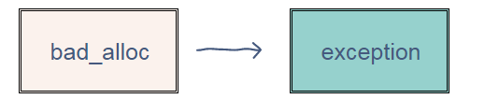
std::bad_alloc
std::bad_alloc is a type of exception that occurs when the new operator fails to allocate the requested space. This type of exception is thrown by the standard definitions of ​operator new (declaring a variable) and operator new[] (declaring an array) when they fail to allocate the requested storage space.

Slide 42
bad_alloc
#include <iostream>
#include <new>
// Driver code
int main () {
try
{
int * myarray = new int[1000000000000];
}
catch (std::bad_alloc& e)
{
std::cerr << "bad_alloc detected: " << exception.what();
}
return 0;
}

Slide 43
std::bad_cast
Type of the exceptions thrown by dynamic_cast when it fails the run-time check performed on references to polymorphic class types.
The run-time check fails if the object would be an incomplete object of the destination type.
Dynamic casts can be used to safely cast a superclass pointer (or reference) into a pointer (or reference) to a subclass in a class hierarchy
#include <typeinfo> // std::bad_cast

Slide 44

std::invalid_argument
#include <exception>
#include <stdexcept>
#include <iostream>
using namespace std;
void findFactorial(int N)
{
int factorial = 1;
try {
if (N < 0) {
throw invalid_argument(
"negative not allowed");
}
// Find factorial if no error occurs
for (int i = N; i > 0; i--) {
factorial *= i;
}
cout << "Factorial of " << N
<< " is " << factorial << endl;
}
catch (exception& e) {
cout << e.what();
}}
// Driver Code
int main()
{
findFactorial(0);
findFactorial(3);
findFactorial(-3);
return 0;
}

Slide 45
Week twelve– Class three

Slide 46
Exception Handling in Filing
#include <fstream>
#include <iostream>
#include <vector>
#include <string>
#include <exception>
using namespace std;
void readIntegerFile(const string& fileName)
{
ifstream istr;
int temp;
char buffer[256];
istr.open(fileName.c_str());
if (istr.fail()) {
throw exception();
}
while (istr)
{
istr.getline (buffer,100);
cout << buffer << endl;
}
}
int main()
{
const string fileName = "test66.txt";
try {
readIntegerFile(fileName);
} catch (exception& e) {
cerr << "Unable to open file " << fileName << endl;
exit (1);
}
cout << endl;
return (0);
}

Slide 47
std::bad_cast
Class A {
virtual void f() { }
};
Class B : public A { };
Class C { };
void f () {
A a;
B b;
A* ap = &b;
B* b1 = dynamic_cast<B*> (&a); // NULL, because 'a' is not a 'B'
B* b2 = dynamic_cast<B*> (ap); //’b’
C* c = dynamic_cast<C*> (ap); // NULL.
A& ar = dynamic_cast<A&> (*ap); // Ok.
B& br = dynamic_cast<B&> (*ap); // Ok.
C& cr = dynamic_cast<C&> (*ap); // std::bad_cast
}
The target type must be a pointer or reference type, and the expression must evaluate to a pointer or reference.

Slide 48

std::bad_cast
// main() method
int main()
{
// try block
try {
Base gfg;
Derived& rd = dynamic_cast<Derived&>(gfg);
}
// catch block to handle the errors
catch (bad_cast& bc) {
cerr << "bad_cast caught: "
<< bc.what() << endl;
}
return 0;
}
Base* gfg = new Derived;
Derived* d;
d = dynamic_cast<Derived*>(gfg);
#include <bits/stdc++.h>
#include <typeinfo>
using namespace std;
// Base Class
class Base {
virtual void member() {}
};
// Derived Class
class Derived : Base {
};
Replacement

Slide 49
Header Files
C++ also offers its users a variety of functions, one of which is included in header files. In C++, all the header files may or may not end with the “.h” extension but in C, all the header files must necessarily end with the “.h” extension. A header file contains:
Function definitions
Data type definitions
Macros

Slide 50
Header Files
In C++ program has the header file which stands for input and output stream used to take input with the help of “cin” and “cout” respectively. There are of 2 types of header file:
Pre-existing header files: Files which are already available in C/C++ compiler we just need to import them.
User-defined header files: These files are defined by the user and can be imported using “#include”.
#include <filename.h> or #include "filename.h”

Slide 51
Create your own Header File:
Write your own C/C++ code and save that file with “.h” extension. Below is the illustration of header file.
// Function to find the sum of two
// numbers passed
int sumOfTwoNumbers(int a, int b)
{
return (a + b);
}

Slide 52
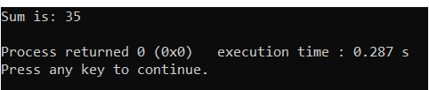
Create your own Header File:cont’d
// C++ program to find the sum of two
// numbers using function declared in
// header file
#include "iostream"
// Including header file
#include "sum.h"
using namespace std;
// Driver Code
int main()
{
// Given two numbers
int a = 13, b = 22;
cout << "Sum is: "
<< sumOfTwoNumbers(a, b)
<< endl;
}
Include your header file with “#include” in your C/C++ program as shown below.
Function calling . Directly control transfer to user define header file . Where proper functionality available over there.

Slide 53
Vectors
The vector class simply provides a dynamic array i.e. an array that can grow as needed
Vectors allocates memory when needed
Although a vector is dynamic, we can still use normal array syntax to access its elements

Slide 54
Advantages of Vectors
The size of a vector does not have to be a fixed constant, and it can also grow or shrink during execution. If you want to read data from a file and store it in an vector, you can just keep adding new elements as you receive them, without having to know what the largest amount would be
A vector always knows its own size, so passing one to a function does not require you to separately pass this information
Elements can be accessed by position in a vector just as they are in an array, but you can also insert and remove elements anywhere in a vector
Vectors can be returned from a function easily

Slide 55
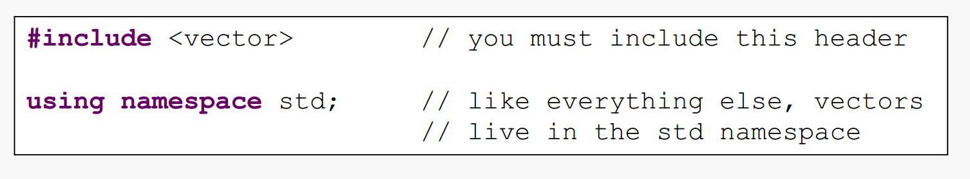
Library

Slide 56
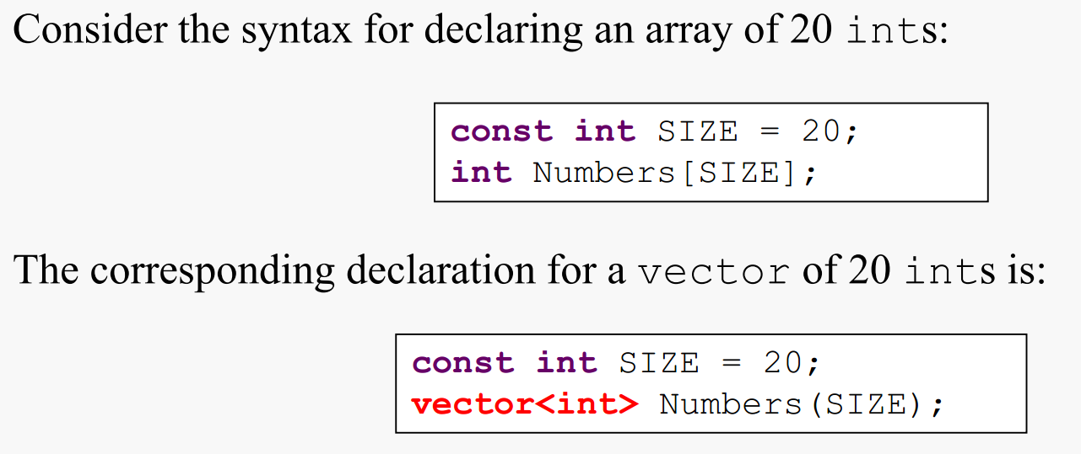
Declaring a Vector
Unlike an array, the elements of a vector are initialized with appropriate default values. This means 0 for ints, 0.0 for doubles, and “” for strings.

Slide 57
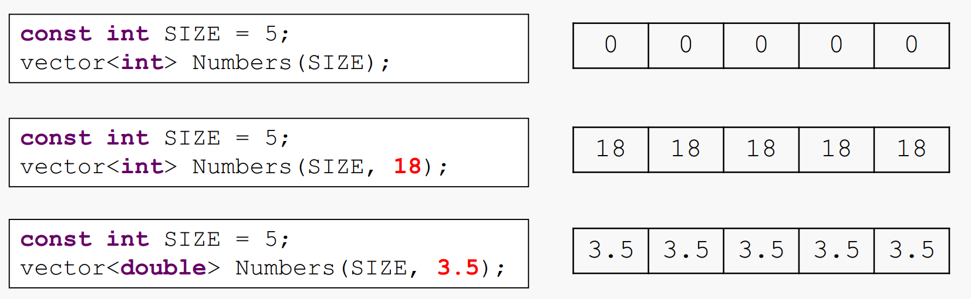
Initializing a Vector

Slide 58
Some useful functions in Vector class
Some of the most commonly used member functions are size( ), begin( ), end( ), push_back( ), insert( ) erase( ), empty(), resize(), clear() and pop_back()
Many other functions and their overloaded versions are also available

Slide 59
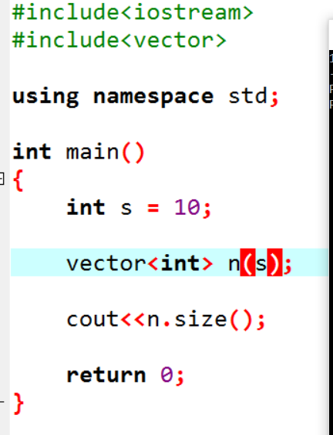
size() function

Slide 60
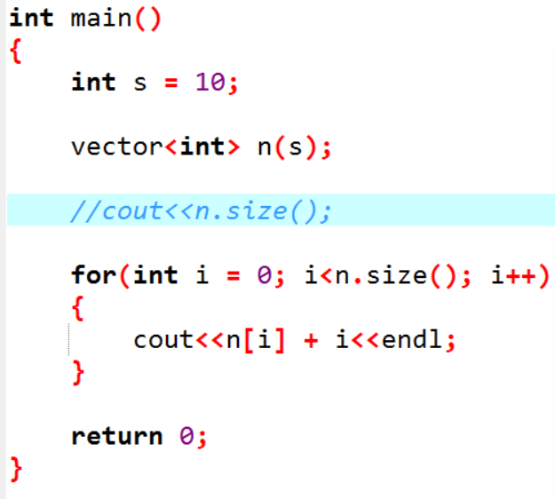
Accessing a Vector

